Slide 1
Medication Adherence
Patient-Facing App
CS 6440: Introduction to Health Informatics - Fall 2016 - Georgia Tech
FHIR STOP is...
Arnab Barua
Adam Hachey (Narrator)
Mark Mullison
Dominick Roselli
Jiankun Sun

Slide 2

Medication Adherence Background
Medication Adherence is the degree to which a patient adheres to a prescribed medication regimen.
“Drugs don’t work in patients that don’t take them” - Former US Surgeon General Dr. C. Everett Koop

Slide 3
Medication Adherence Background
Adherence generalization:
1/3 patients are compliant
1/3 patients are non-compliant because of misunderstanding the treatment plans
1/3 patients are non-compliant as an informed conscious choice to be non-compliant
Redman, B. (1984). The process of patient education. 5th Ed. St. Louis: C V Mosby Co.
Ngoh LN (2003). "Health literacy: a barrier to pharmacist-patient communication and medication adherence". J Am Pharm Assoc.
Elliott RA, Marriott JL (2009). "Standardised assessment of patients' capacity to manage medications: a systematic review of published instruments". BMC Geriatr.
Notes:
These results are from a source in 1984, but multiple sources within the past 8-15 years suggest that improvement is slow. We’re still seeing the same issues in patient compliance.

Slide 4
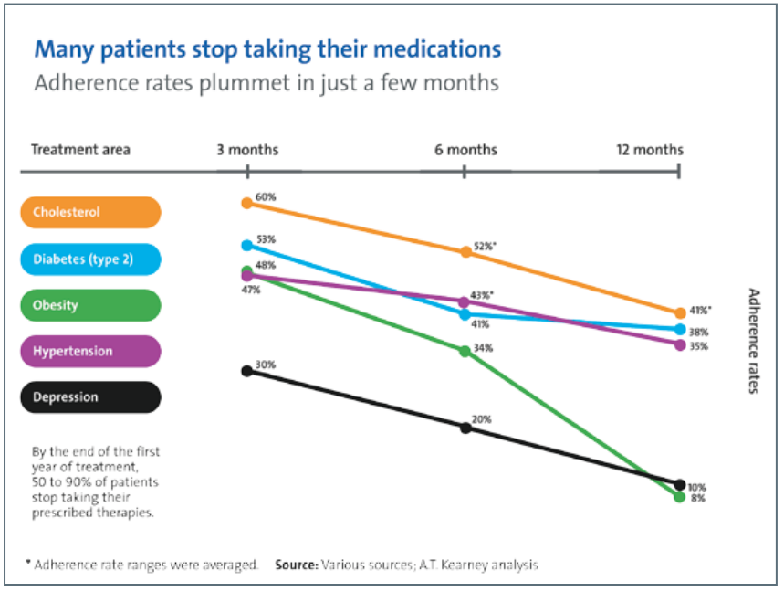
Medication Adherence Background
Marquess, Jonathan G., PharmD, CDE. "Partnering With Your Community Pharmacist." Editorial. Media Planet: Patient Adherence Mar. 2012, 2nd ed.: 7. Mediaplanet.com. Mediap Planet U.S.A., Mar. 2012. Web. 25 Oct. 2013. <http://doc.mediaplanet.com/all_projects/7711.pdf>.
Notes:
Adherence rates decrease over time - shows patients who do initially understand their treatment plans seem to lose sight of that over time.

Slide 5
Costs of Low/Non-Adherence
Annual Cost in 2010: $290 billion
Other stats:
125,000 Americans die annually from low medication adherence
Ten to 25% of hospital and nursing home admissions result from poor compliance
Up to 40% of patients don’t adhere to their treatment regimes
Up to 20% of new prescriptions go unfilled.
Rates of non-adherence have been stagnant over the past three decades
Adapted from The 21st Century Intelligent Pharmacy Project: The Importance of Medication Adherence, 2010, Center for Health Transformation, page 1.
Notes:
Shocking stats… it’s a big problem and clearly there’s value in solving it.

Slide 6
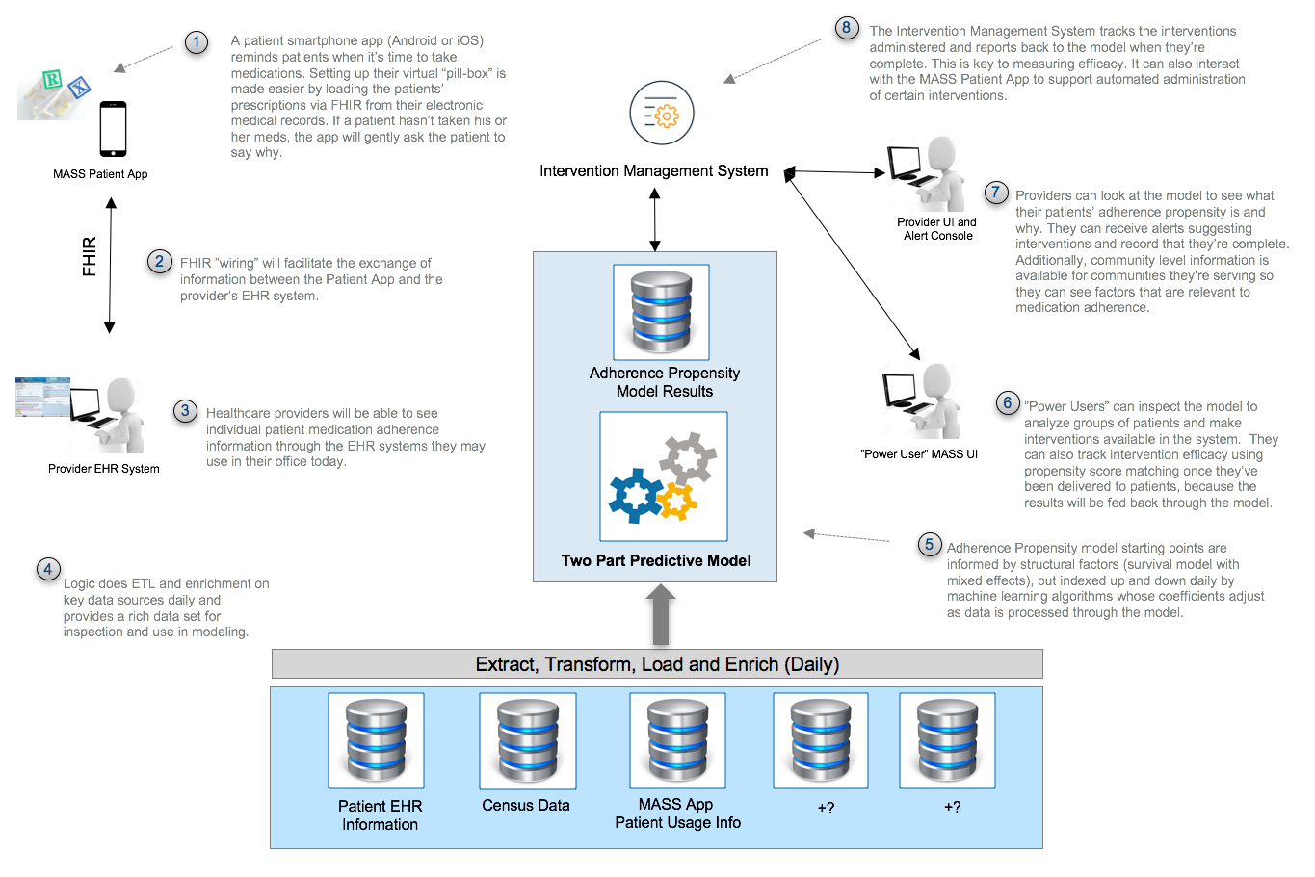
Medication Adherence Support System (MASS): Conceptual Architecture
Notes:
This is a big, multi-part problem. Here’s a look at a first draft of the conceptual architecture we’ve put together to get at it.
There’s a lot on this page. If you’re interested in digesting it a bit more, just press the pause button or you can also view this in our GitHub repo in our TopicPresentation folder.
The solution has five main components:
First, there is a mobile app for patients that acts as their virtual “pill-box”, letting them setup reminders for medications. There are lots of apps available now that do that, but this one is different in two main ways— it gets prescriptions from the patient’s EHR via FHIR which makes it easier to setup and ensures that they’re all accounted for. And also it captures patient behavior information, including gently asking them to account for why they may have missed a dose if they did.
Second, there’s a “big-data” store and analytics component that’s used to model degrees of patient medication adherence, and also supports analysis of intervention efficacy.
Third, there is an “intervention management system” that allows administration of automated interventions (for example “Did you know that patients who take their blood pressure meds at night have a 30% less chance of having a heart attack?” or whatever).
Fourth, there’s wiring that ensures as much data as is supported by FHIR finds its way into the patient’s EHR so that it can be accessed through other applications (e.g., a provider’s existing EHR system).
And lastly, there is a provider UI which augments the existing EHR. This UI is focused on allowing them to inspect both patient and community medication adherence information and identify important influencing factors.
It’s a big vision, with the potential for a lot of impact—but it's going to be way more work than we have time for this semester. We’ll evolve this conceptual architecture throughout the semester but our focus will be on building a POC of the patient App this semester on the Android platform.

Slide 7
MASS Patient-App Overview
Medication reminders
Synced prescriptions from EMR system
Await confirmation from user when medication is taken
Missed medication warning system
Timed reminders with educational info according to severity of missed medication
Optional survey questions asking why medication was missed or late
Treatment plan education
Description of medication and how it helps
Consequences of deviating from treatment

Slide 8



Research Requirements
Medication adherence background
Current apps in the market
Ideal survey data
Interviews with prospective app users
Medical Adherence Apps: http://blog.evisit.com/top-apps-improve-medication-adherence
Notes:
We’ve already started looking into some of these things..

Slide 9
How Will FHIR Be Incorporated?
Medication reminders
Patient, Medication, MedicationOrders resources used to retrieve medications
MedicationAdministration created when medication is taken
Missed medication warning system
Questionnaire and QuestionnaireResponses resources used for surveys
Treatment plan education
Medication resources used to describe the medication to the patient
Notes:
Assumes we are able to create all available FHIR resources and properties
FHIR Resource list: https://www.hl7.org/fhir/resourcelist.html
We may need to use more resources as we start developing and fleshing out more requirements

Slide 10
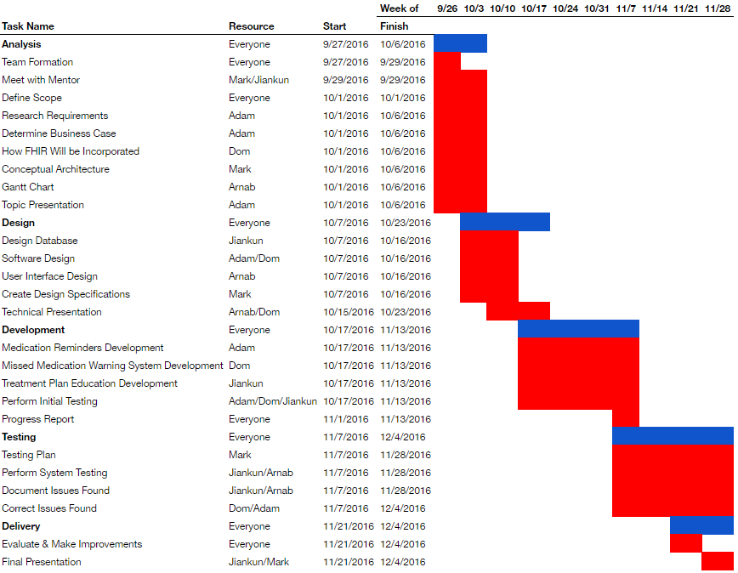
Notes:
Our Gantt Chart has been broken down into 5 phases (Analysis, Design, Development, Testing, Delivery)
In each phase, there are multiple tasks that have been broken down and assigned to individuals
Though we have set dates and expectations, our framework for the team will be agile.

